Slide 1
Opportunity Name
Opportunity Qualification
CRM Number: | xxx
CRM Status | xxx
Market Survey Date: | xxx
Anticipated DRFP Date: | xxx
Anticipated RFP Date: | xxx
BDM/Acct Manager, xxxxxxxxxx
Operations Manager, xxxxxxxxxx
Division Manager, xxxxxxxxxx

Slide 2
Procurement Basics
Basic Information
Nature of the Work
Contract Length:
Number of FTEs:
 | Base Year | Option Year 1 | Option Year 2 | Option Year 3 | Option Year 4
FTE
$
Scope of Work:
Type of Work:
Work Location:
Technologies/Tools:
Risks:
Constraints:
Basic/Total Value:
Projected B&P Costs:
Contract Type:
OCI/PCI?:
SPC Issues?:
Buyer Organization:
Competitive Landscape
Schedule / Milestones
Incumbent(s):
Known Primes:
Other Potential Players
Enterprise opportunity?
Likely Team:
FOIA Requests:
Probability of Win (reported)
Probability of Win (qualitative):
Rationale:
Milestone | Date and/or Status
Date of last visit
Market Survey
RFI
Bidders Conference
Draft RFP
Final RFP
Proposal Due
Award
POP

Slide 3
Qualification:
Does the opportunity align with business objectives?
Do we have the ability to do the work?
Is there funding for this program?
Have we made contact with customer? Does he/she have first party pain?
Have we made contact with COTR and/or CO?
Is there a Definitive Schedule for the program?
Is there an incumbent? If so, where are their vulnerabilities?
Should we pursue this opportunity? If so, why?
You may need to dive deeper in one for more of these questions, but try to start with focused bullets. If a question comes up, you can always bring up a supporting slide.

Slide 4
Value Proposition(s)
What will the customer get when he awards a contract to us?
Why would they pick us?
See slides in second section
Try to focus on just a few value props, but keep them focused and easily understood

Slide 5
Decision on Pursue or No Pursue
Recommendation to Pursue or Not to Pursue
Don’t make decision makers guess where you stand. Give them your answer before they give you theirs.

Slide 6
Next Steps

Slide 7
Building Value Propositions

Slide 8

Creating Value Propositions
Jim Allen

Slide 9
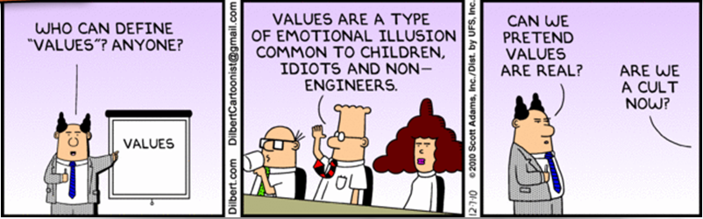
Value

Slide 10
How do we determine Value?
equivalent worth or return in money, material, services, etc.: to give value for value received.
the worth of something in terms of the amount of other things for which it can be exchanged or in terms of some medium of exchange.
the desirability of a thing, often in respect of some property such as usefulness or exchangeability; worth, merit, or importance

Slide 11
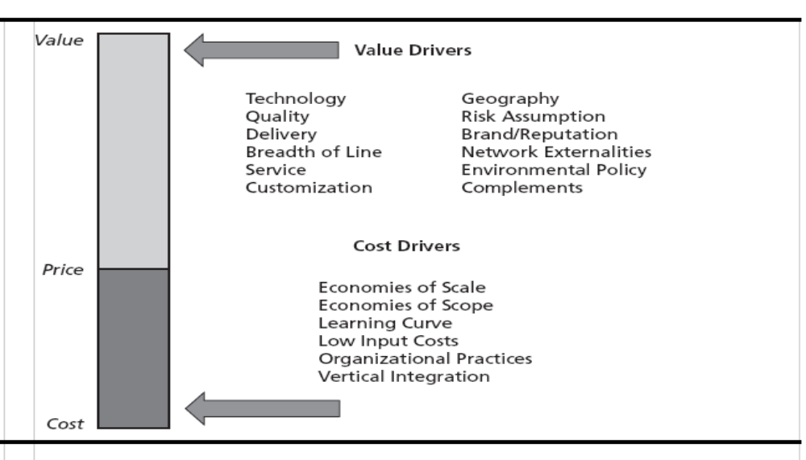
Value, Price and Cost (VPC) drivers
Economics
WTP
WTP – Willingness to Pay (what is it worth?)

Slide 12
Impacts to Value
Porter’s Five Forces Analysis
Threat of New Entry
Economies of scale
Proprietary product differences
Brand identity
Switching costs
Capital requirements
Access to distribution
Absolute cost advantages
Government policy
Expected retaliation
Bargaining Power
of Suppliers
Bargaining Power
of Customers
Differentiation of inputs
Switching costs
Presence of substitute inputs
Supplier concentration
Importance of volume to supplier
Cost relative to total purchases
Impact of inputs on cost or differentiation
Threat of forward integration
Rivalry Among Existing Competitors
Buyer concentration
Buyer volume
Buyer switching costs
Buyer information
Ability to integrate backward
Substitute products
Price / total purchases
Product differences
Brand identity
Impact of quality / performance
Buyer profits
Industry growth
Fixed costs / value added
Overcapacity
Product differences
Brand identity
Switching costs
Concentration and balance
Informational complexity
Diversity of competitors
Corporate stakes
Exit barriers
Threat of Substitutes
Relative price performance of substitutes
Switching costs
Buyer propensity to substitute
Source: Michael E. Porter, Competitive Advantage (New York: Free Press, 1985)

Slide 13
The Desirability of a Thing from the customer’s perspective
“Rule 17: Try honestly to see things from the other person’s point of view”
Dale Carnegie’s
Golden Book
What does the customer want?
Not what do we want to sell?

Slide 14
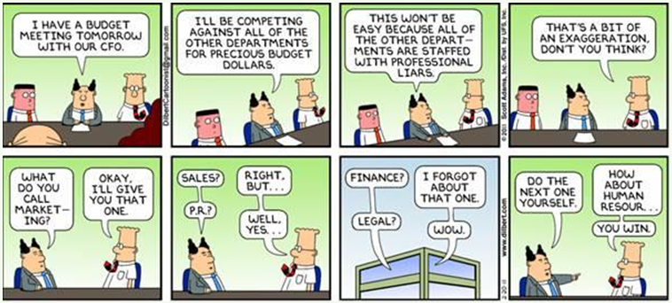
How does the customer see industry?

Slide 15
Value Prop Template
Customer will “get”..”realize”..”enjoy”
Specific benefit
Because our approach, product, service provides
Added value statement
We have the ability to provide this value because
Proof of our ability.
Where have we done it before
Conclusion
Summary of value proposition

Slide 16
Example: Value Proposition
Customer will enjoy
an expanded breadth and depth in training for ever evolving tools and techniques as technology progresses.
Because our approach brings added value of
combining our strengths in system engineering, system integration, instructional design and training.
We have proven this approach is effective
in the work we have performed in developing training for our planning, integration and training for the CASE1, CASE2 and CASE3 programs.
Conclusion
By coupling our instructional expertise with the underling disciplines of planning, engineering and integration, we are able to provide the best available training.

